Slide 1

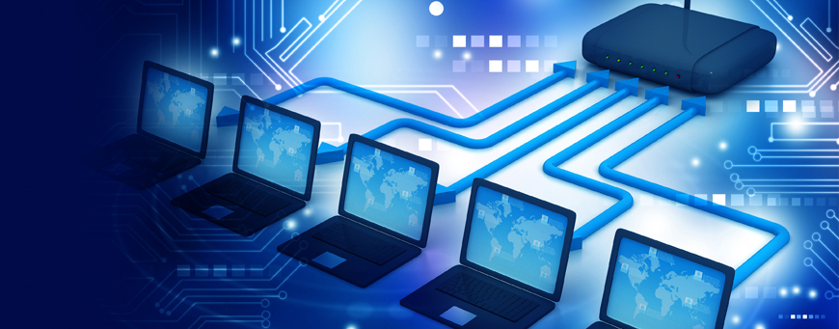
Introduction
CSE306: Computer Network

Slide 2
Computer Networks ?
Collection of interconnected devices
Enables resource sharing
Facilitates information exchange
Improves communication efficiency
Supports collaboration and connectivity
Forms the backbone of IT systems

Slide 3
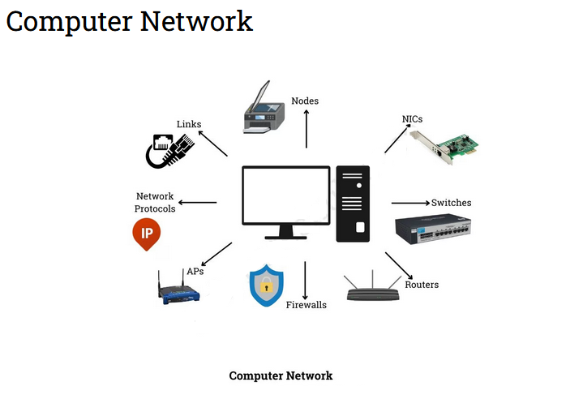

Slide 4
Use of Computer Networks in real life:
The internet
Online shopping
Wearable health care systems
Television
Personal area network (PAN)
Cloud networks

Slide 5
Applications:
Communication
Enables email and messaging services.
Data Sharing
Supports file transfers and shared drives.
Internet Access
Connects LANs to the global internet.

Slide 6
Cloud Computing
Provides remote storage and applications.
IoT
Connects smart home devices like Alexa.
Collaboration
Enhances teamwork with shared resources.

Slide 7
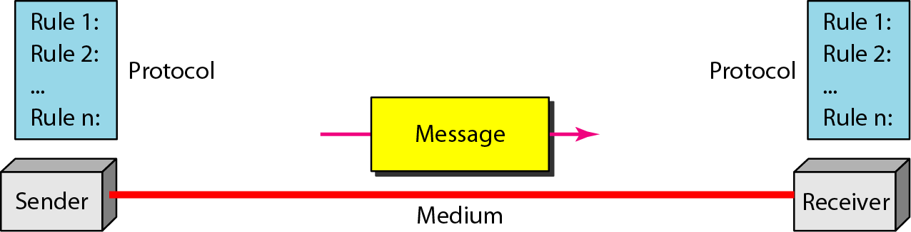
Components of a Data Communication System

Slide 8
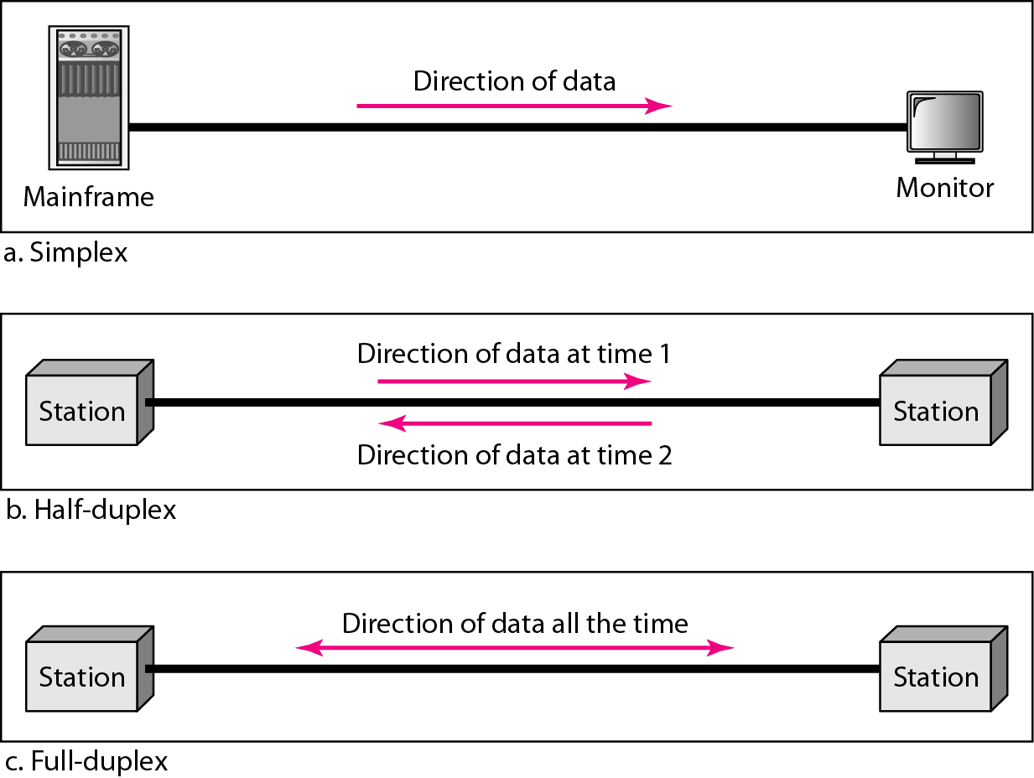
Data flow (Simplex, Half-duplex, and Full-duplex

Slide 9
Rhyme Puzzle: “Three Lanes of Chat” I’m three kinds of talking on digital streets, Guess which lane each riddle meets.
A lighthouse of packets beams out to the bay— Many can hear me, none answer my way. Which lane am I?
Tap, wait, then reply—like kids with one mic. Only one voice at once; then we swap when we like. Which lane am I?
Two rivers run side by side, never collide; We both speak at once as the bits glide. Which lane am I?
Siren that shrieks to all floors in the hall; It never takes feedback—it just warns them all. Which lane am I?
Notes:
1) Simplex 2) Half-duplex 3) Full-duplex 4) Simplex

Slide 10
Networks and Types
LAN: Local Area Network.
MAN: Metropolitan Area Network.
WAN: Wide Area Network.
PAN: Personal Area Network
WLAN: Wireless Local Area Network

Slide 11
LAN: Local Area Network
Small-scale network within a building.
Connects devices in a limited area.
Used in offices, schools, and homes.
Provides high speed at low cost.
Enables resource and data sharing.
Commonly includes computers, printers, and switches.

Slide 12
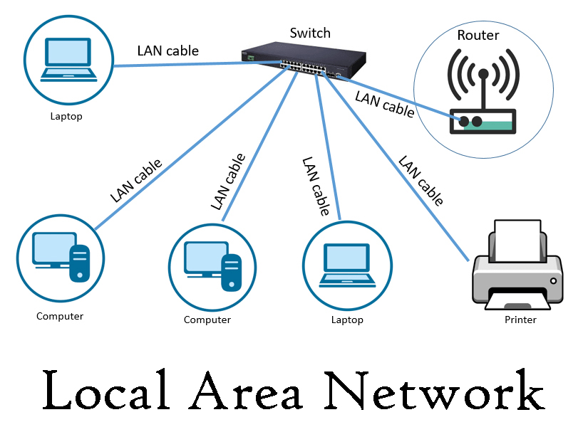

Slide 13
MAN: Metropolitan Area Network
Covers a city or metropolitan area.
Connects multiple LANs within a region.
Used by ISPs, universities, and businesses.
Provides moderate speed and coverage.
Facilitates inter-LAN communication.
Typically relies on fiber optics or wireless links.

Slide 14
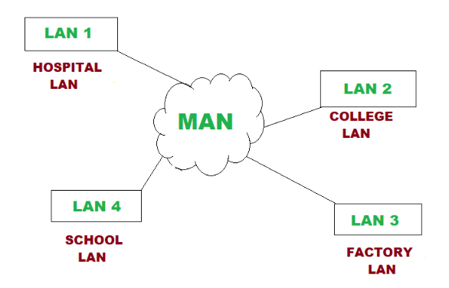

Slide 15
WAN: Wide Area Network
Covers large geographic areas.
Connects multiple MANs and LANs.
Used for global communication like the Internet.
Provides lower speed compared to LANs.
Utilizes satellites, fiber optics, and leased lines.
Supports business, government, and personal use.

Slide 16
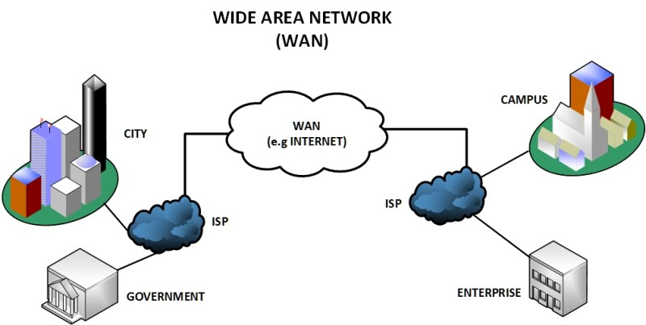

Slide 17
PAN: Personal Area Network
Covers a very small area, like a room.
Connects personal devices smartphones and laptops.
Common technologies like Bluetooth and USB.
Personal communication and data sharing.
Provides short-range, low-power connectivity.
Examples include wireless keyboards & headphones.

Slide 18
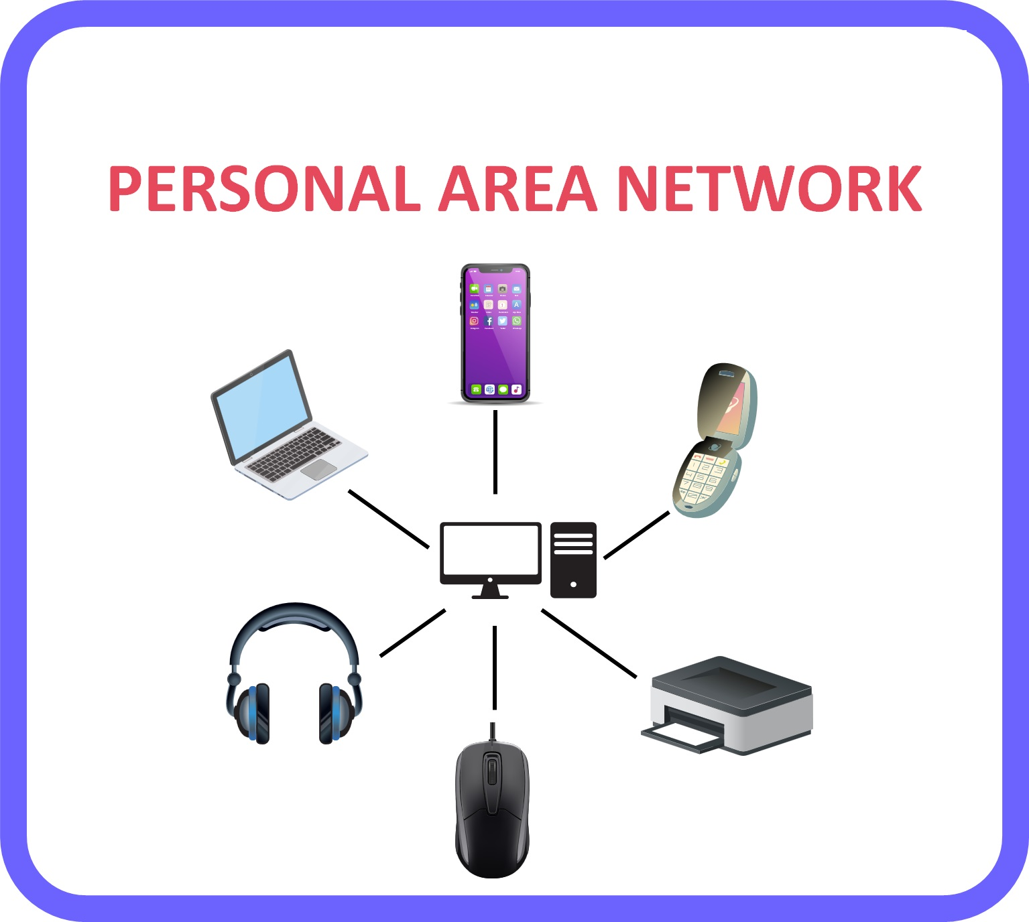

Slide 19
WLAN: Wireless Local Area Network
Connects devices wirelessly within local area.
Uses Wi-Fi technology for communication.
Common in homes, offices, public spaces.
Provides flexibility and mobility for users.
Supports multiple devices simultaneously.
Access points & routers used for connectivity.

Slide 20
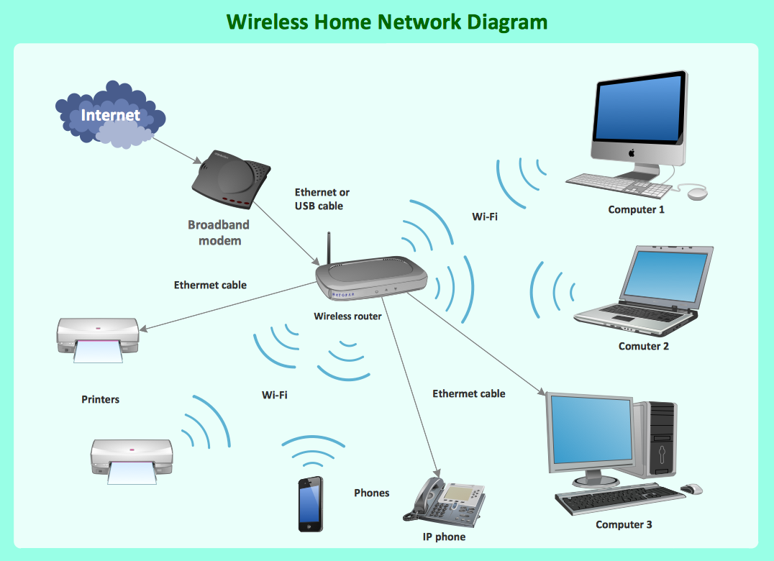

Slide 21
Introduction to the Internet
Global network connecting millions of devices.
These are private, public, academic.
Business, and government networks.
Enables sharing of information and communication.
Uses standardized communication protocols.

Slide 22
What is a Browser
Software application for accessing information on the web.
Examples: Chrome, Firefox, Safari.
Translates web pages from web servers Into human-readable format.

Slide 23
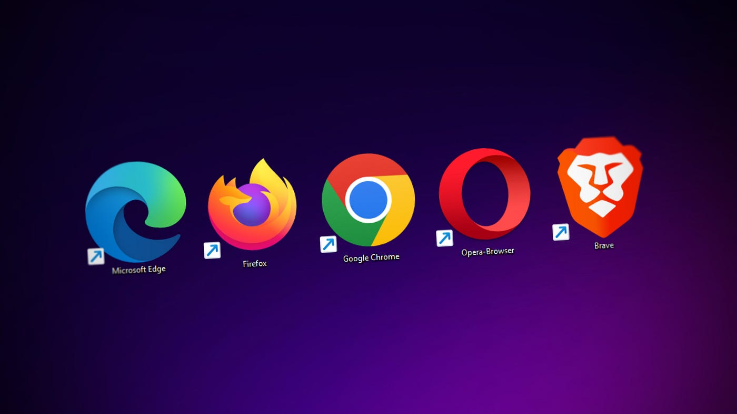

Slide 24
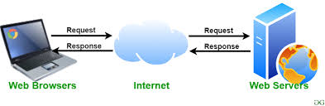
What is a Web Server
Computer system that hosts websites.
Delivers web pages to users upon request.
Uses HTTP/HTTPS protocols.

Slide 25
Understanding URLs
Stands for Uniform Resource Locator.
Address used to access web pages.
Consists of protocol, domain, and path

Slide 26
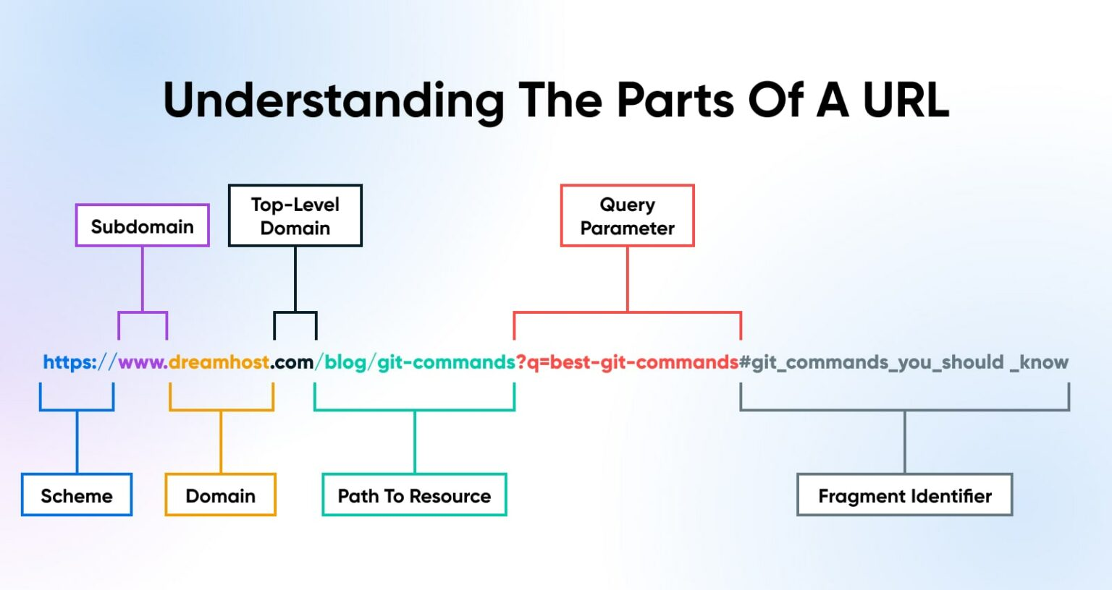

Slide 27
What is a Domain Name
Human-readable address of a website.
Maps to an IP address.
Example: www.google.com.

Slide 28
What is an IP Address?
Unique identifier for a device on a network.
IPv4: 192.168.0.1
IPv6: 2001:0db8:85a3:0000:0000:8a2e:0370:7334

Slide 29
What are Packets?
Small units of data transmitted over a network.
Contains source, destination, and data payload.
Essential for data transmission on the internet

Slide 30


Slide 31


